Slide 1
Python Basics

Slide 2
Install Python
Go to this link https://www.python.org/downloads/windows/ and download the latest python 3 release.
After installing open cmd and type “pip3 install jupyter”

Slide 3
Introduction to Python
Python is a “high-level programming language and its core design philosophy is all about code readability and a syntax which allows programmers to express concepts in a few lines of code” created by Guido van Rossum.
Another reason is that we can code in Python to multiple uses: data science, web development, machine learning shine here. Quora, Pinterest and Spotify use Python for their backend web development for example.

Slide 4
Python is a high-level general purpose programming language
Because code is automatically compiled to byte code and executed, Python is suitable for use as a scripting language, Web application implementation language, etc.
Because Python can be extended in C and C++, Python can provide the speed needed for even compute intensive tasks.
Because of its strong structuring constructs (nested code blocks, functions, classes, modules, and packages) and its consistent use of objects and object-oriented programming, Python enables us to write clear, logical applications for small and large tasks.
Notes:
Bytecode is a virtual machine that converts generalized machine instructions into specific machine instructions so the host platform can execute the instructions, for example windows line of machine are one platform and Apple and Linux are another, Using bytecode your program statements need to be compiled once and can run on any platform
Compiler is a computer program the transform a specific programming language into the target programing language.

Slide 5
Important features of python
Built-in high level data types: strings, lists, dictionaries, etc.
The usual control structures: if, if-else, if-elif-else, while, plus a powerful collection iterator (for).
Multiple levels of organizational structure: functions, classes, modules, and packages. These assist in organizing code. An excellent and large example is the Python standard library.
Compile on the fly to byte code -- Source code is compiled to byte code without a separate compile step. Source code modules can also be "pre-compiled" to byte code files.
Object-oriented -- Python provides a consistent way to use objects: everything is an object. And, in Python it is easy to implement new object types (called classes in object-oriented programming).
Extensions in C and C++ -- Extension modules and extension types can be written by hand. There are also tools that help with this, for example, SWIG, sip, Pyrex.
Jython is a version of Python that "plays well with" Java.

Slide 6
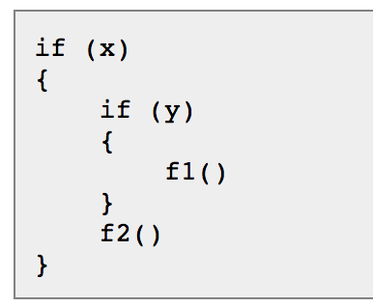
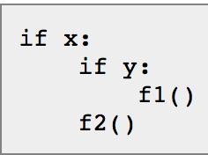
Python Coding structure
In C-Style Code you will write
a code block like this:
In Python it’s like this:
Notes:
Python uses indentation to show block structure. Indent one level to show the beginning of a block. Out-dent one level to show the end of a block.
And, the convention is to use four spaces (and no hard tabs) for each level of indentation. Actually, it's more than a convention; it's practically a requirement. Following that "convention" will make it so much easier to merge your Python code with code from other sources.

Slide 7
An overview of Python
A scripting language -- Python is suitable (1) for embedding, (2) for writing small unstructured scripts, (3) for "quick and dirty" programs.
Not a scripting language -- (1) Python scales. (2) Python encourages us to write code that is clear and well-structured.
Interpreted, but also compiled to byte-code. Modules are automatically compiled (to .pyc) when imported, but may also be explicitly compiled.
Indented block structure -- "Python is pseudo-code that runs.”
Comparison with other languages: compiled languages (e.g. C/C++); Java; Perl, Tcl, and Ruby. Python excells at: development speed, execution speed, clarity and maintainability.

Slide 8
Dynamic -- For example:
Types are bound to values, not to variables.
Function and method lookup is done at runtime.
Values are inspect-able.
You can list the methods supported by any given object.
Strongly typed at run-time, not compile-time. Objects (values) have a type, but variables do not.
Reasonably high level -- High level built-in data types; high level control structures (for walking lists and iterators, for example).
Object-oriented -- Almost everything is an object. Simple object definition. Data hiding by agreement. Multiple inheritance. Interfaces by convention. Polymorphism.
Highly structured -- Statements, functions, classes, modules, and packages enable us to write large, well-structured applications. Why structure? Readability, locate-ability, modifiability.

Slide 9
Program Structure
Execution -- def, class, etc are executable statements that add something to the current name-space. Modules can be both executable and import-able.
Modules correspond to files with a "*.py" extension. Packages correspond to a directory (or folder) in the file system; a package contains a file named "__init__.py". Both modules and packages can be imported.

Slide 10
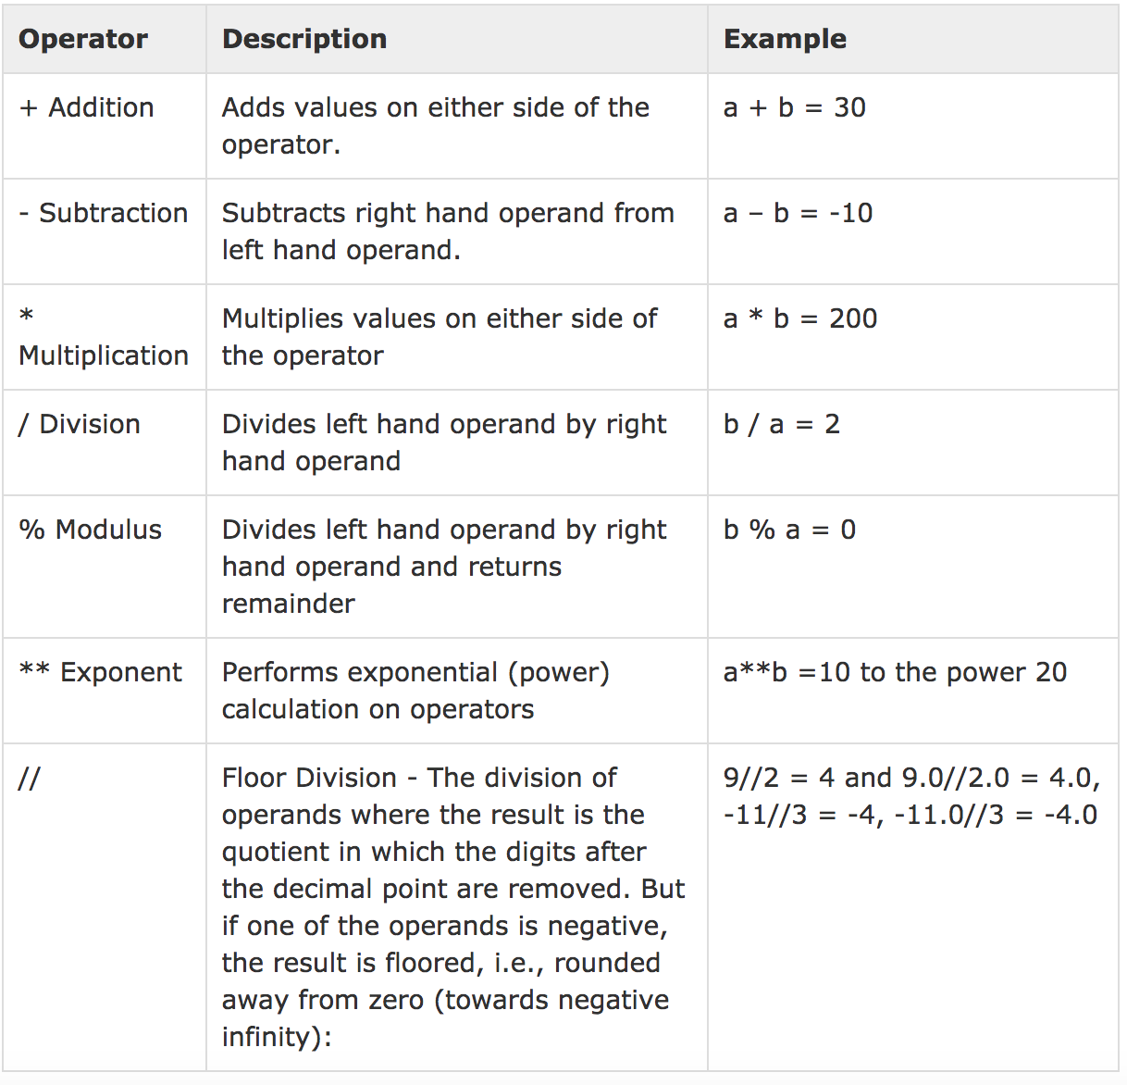
Arithmetic operators

Slide 11
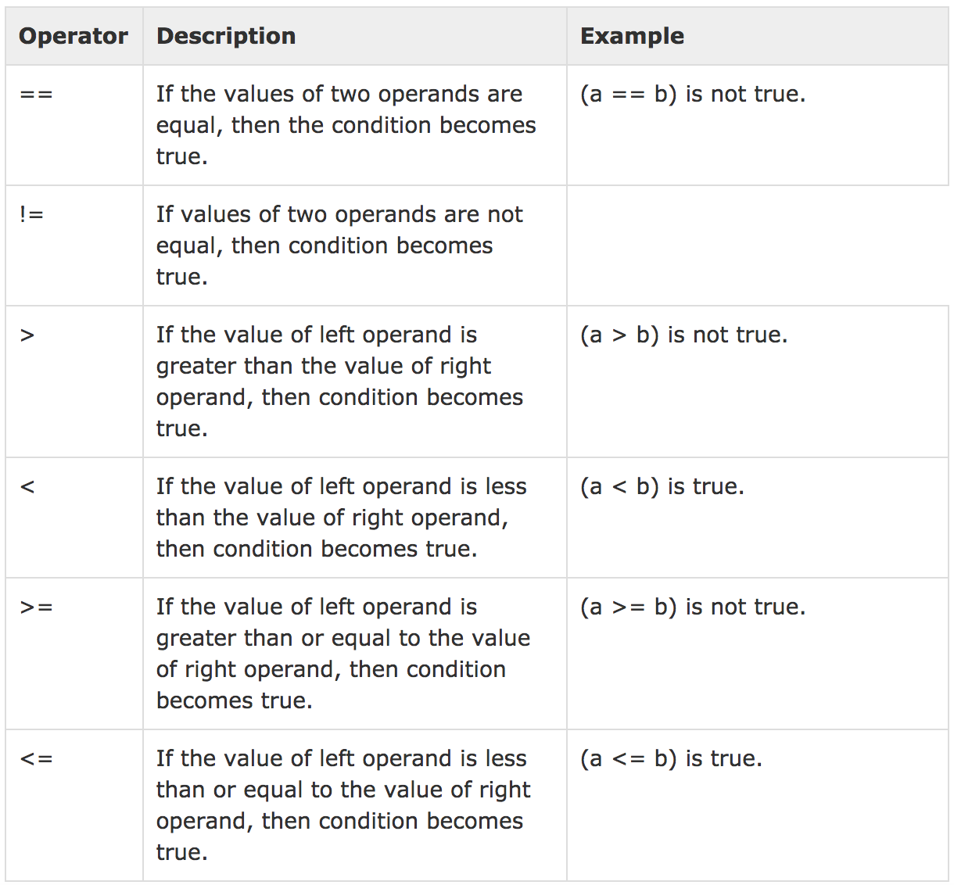
Comparison Operator

Slide 12
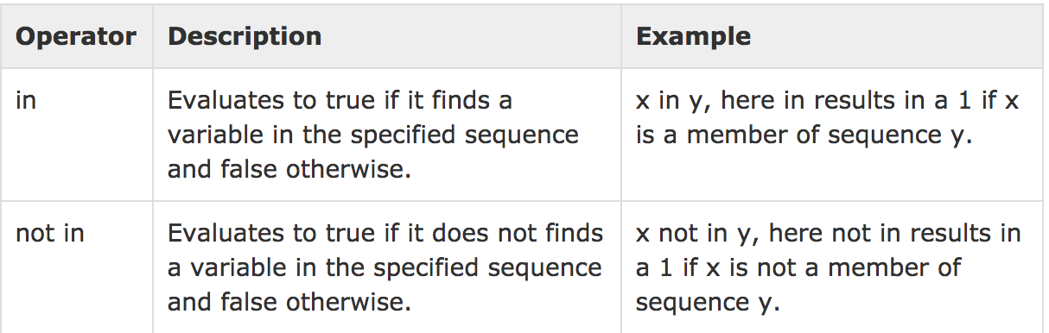
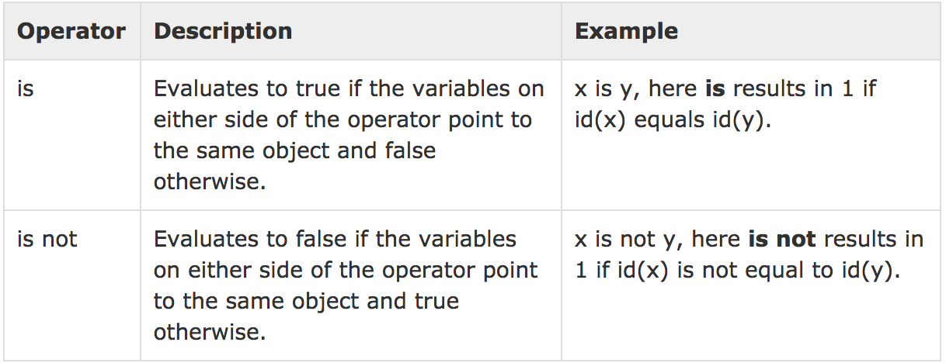
Membership Operator
Identity Operator

Slide 13
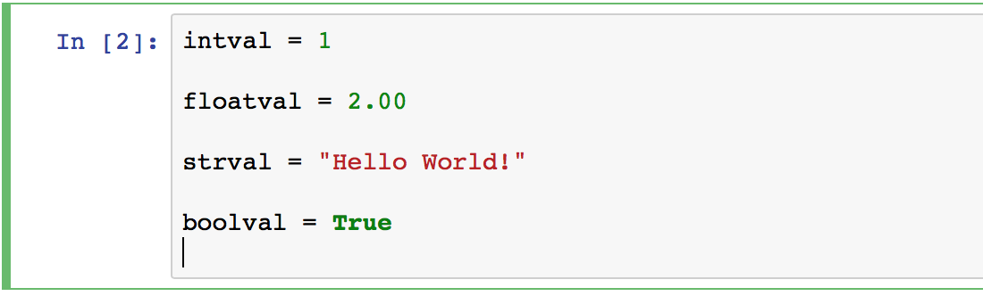
Variables
Types are bound to values, not to variables.

Slide 14
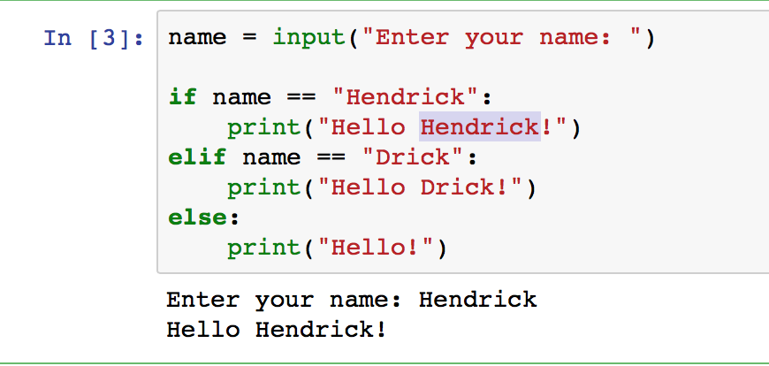
Conditional Statements

Slide 15
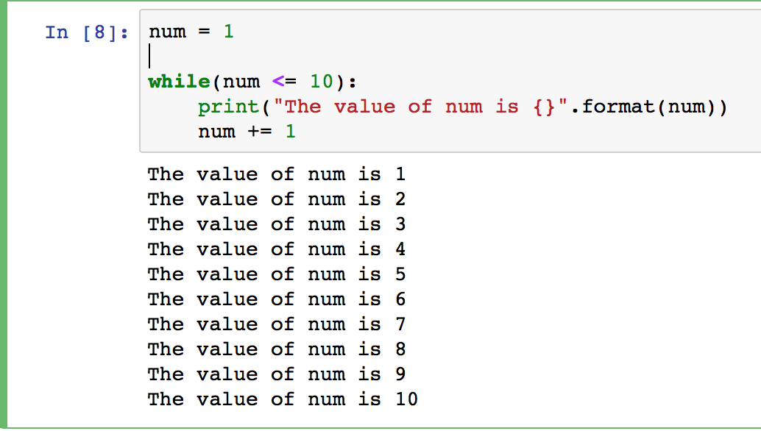
Looping/iterator
While Loop:

Slide 16
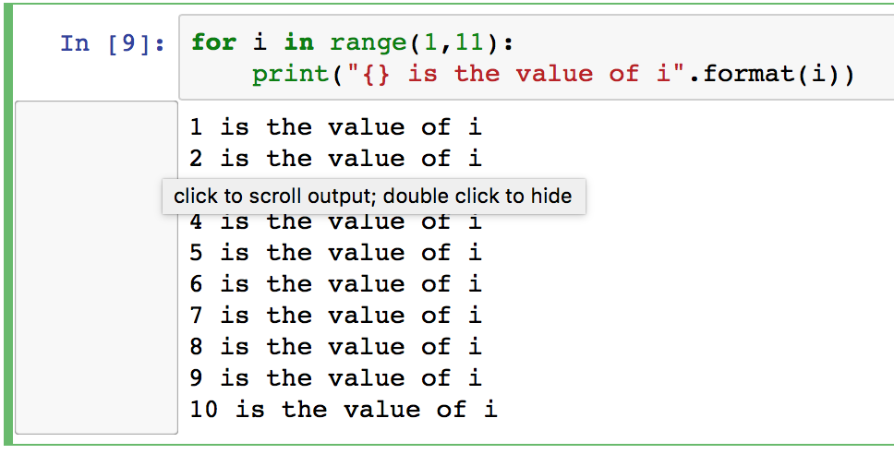
Iterator:

Slide 17
Coding Using Jupyter
Go to cmd and type “jupyter notebook”
A browser will open showing a file explorer. That will serve as your IDE.
Jupyter notebooks are good in creating proof of concepts and for educational purposes I will not suggest to use it in an actual project implementation.

Slide 18
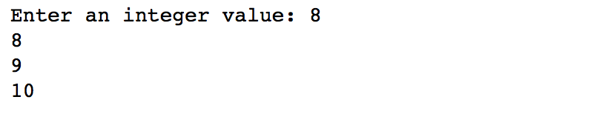

Excercises
Exercise 1: Create a program that accepts integer input and outputs if the number is odd or even.
Exercise 2: Create a program that accepts a number then displays the value incremented by 1 till it reaches 10, if the input is greater than 10 display ”Invalid input”. Example:

Slide 19
Lists
List -- A list is a dynamic array/sequence. It is ordered and indexable. A list is mutable.
List constructors: [], list().
Notes:
What is a constructor? A constructor is a special method of a class that initializes the an object of that type.

Slide 20
Operations on List
list1 + list2, list1 * n, list1 += list2, etc.
Comparison operators: <, ==, >=, etc.
Test for membership: in
Append -- mylist.append(newitem).
Insert -- mylist.insert(index, newitem). Note on efficiency: The insert method is not as fast as the append method. If you find that you need to do a large number of mylist.insert(0, obj) (that is, inserting at the beginning of the list) consider using a deque instead.

Slide 21
Extend -- mylist.extend(anotherlist). Also can use + and +=.
Remove -- mylist.remove(item) and mylist.pop(). Note that append() together with pop() implements a stack.
Delete -- del mylist[index].
Pop -- Get last (right-most) item and remove from list -- mylist.pop().

Slide 22
Excercises
Exercise 1: create an empty list and append 4 string values to it, then pop the last value.
Exercise 2: Use “for” statement to print values from the list.
Exercise 3: Create a program that accepts 3 values from user then adds it to a list, after 3 inputs the list values will be printed

Slide 23
Dictionaries
A dictionary is a collection, whose values are accessible by key. It is a collection of name-value pairs.
The order of elements in a dictionary is undefined. But, we can iterate over (1) the keys, (2) the values, and (3) the items (key-value pairs) in a dictionary. We can set the value of a key and we can get the value associated with a key.
Keys must be immutable objects: ints, strings, tuples, ...
Notes:
Immutable are values that can’t change, for instance concatenating a 2 string value will create a third string value containing the concatenated string and then destroys it when assigned to the variable, mutable are objects that you can alter directly.

Slide 24
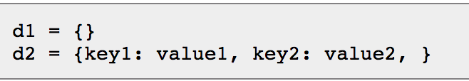
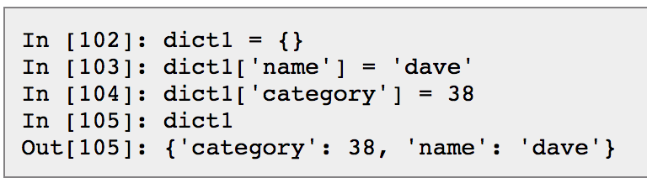
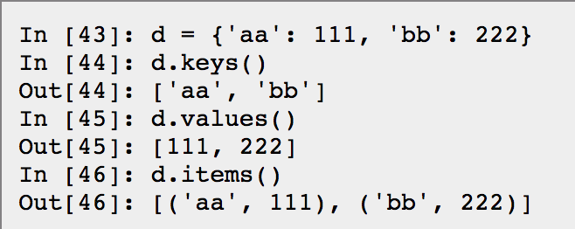
Literals for Creating dictionaries:
Indexing a dictionary
Some of dictionary operators:

Slide 25
Excercises
Create a dictionary with the values: 'aa': 111, 'bb': 222, 'cc': 333.
Create a statement that iterate over (1) the keys, (2) the values, (3) the items in the dictionary

